Slide 1
Last Week
This Week
Manuscript preparation
Manuscript preparation
Manuscript 결과 데이터 정리

Slide 2
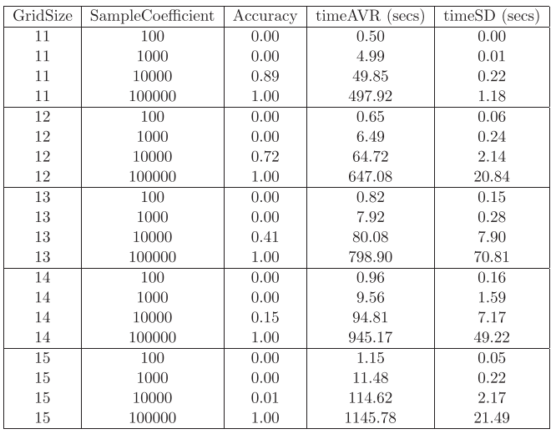
Additive Reinforcement Learning Algorithm (ARLA) Example
0 | 1 | 1 | 0 | 1
Sequences
scores
Sequences * scores
1 | 0 | 1 | 0 | 1
5-2=3
3 | 0 | 3 | 0 | 3
0 | 1 | 0 | 1 | 0
5-3=2
Sequence * score
0 | 2 | 0 | 2 | 0
Sum
0 | 0 | 1 | 0 | 0
5-2=3
0 | 0 | 3 | 0 | 0
0 | 1 | 1 | 1 | 1
5-1=4
0 | 4 | 4 | 4 | 4
Substract min.(=3)
3 | 6 | 10 | 6 | 7
0 | 3 | 7 | 3 | 4
Average = 3.4
e_{i}> average: 1
e_{i}< average: 0
Result sequence
score
0 | 0 | 1 | 0 | 1
5-1=4

Slide 3
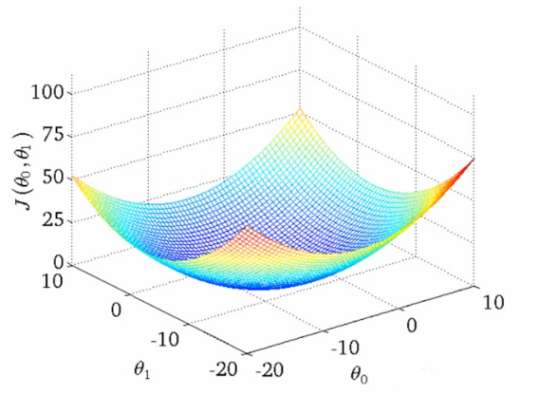
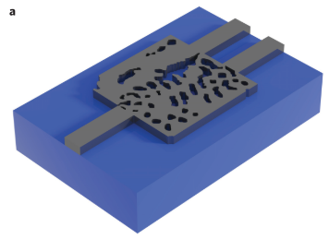







Inverse Design Process
FDTD
$x_{A}$
$$f\left(x\right)$$
$$y_{A}$$
$${FOM}_{A}$$
structure
spectrum
minimize
Cost function
$$\frac{1}{FOM_{A}}, Const.−FOM_{A}$$
Minimize by gradient descent algorithm
Gradient
$$Cost$$
$x_{A, ij}$
A. Y. Piggott et al., Nature Photonics, vol. 9, no. 6, pp. 374–377, Nov. 2015.

Slide 4
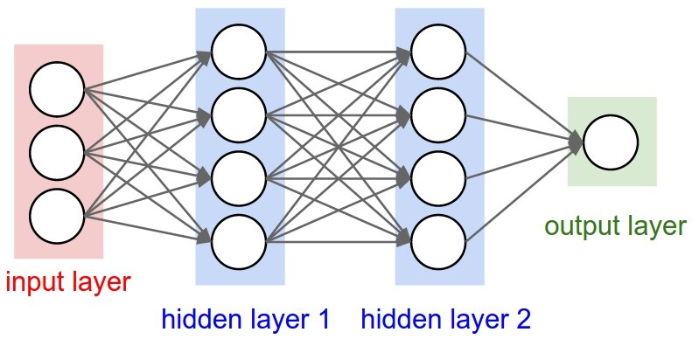




Inverse Design Process
Learning
Neural
Network
$x_{A}$
$$f\left(x\right)$$
$$y_{A}$$
$${FOM}_{A}$$
structure
spectrum
minimize

Slide 5
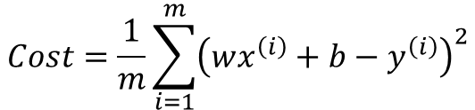


Inverse Design Process
bias
Perceptrons (1957)
b
Training Data
x | y
1 | 2
2 | 3
3 | 4
x
1
2
3
Activation
function
y
2
3
4
weight
:
x
w
wx+b
y
$$Cost=\frac{1}{m}\sum_{i=1}^{m}{{\left(wx^{\left(i\right)}+b−y^{\left(i\right)}\right)}^{2}}$$
Gradient
$$Cost$$
$$W$$
$$b$$

Slide 6
Inverse Design Process
bias
Perceptrons (1957)
b
Training Data
x | y
1 | 2
2 | 3
3 | 4
x
1
2
3
Activation
function
y
2
3
4
weight
:
x
w
wx+b
y
b = 1
w = 1
bias
1
Activation
function
x
4
weight
y
5
x
1
wx+b
y

Slide 7

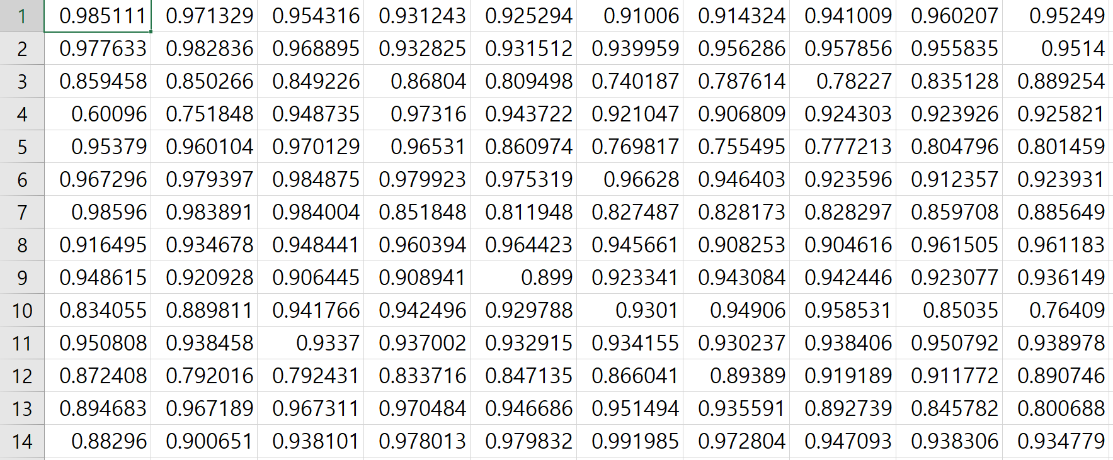




Inverse Design Process
Multi-Layer Perceptrons (MLP)
structures
spectrum
Neural
Network
$x_{A}$
$$f\left(x\right)$$
$$y_{A}$$
$${FOM}_{A}$$
structure
spectrum
minimize

Slide 8
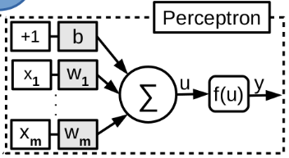
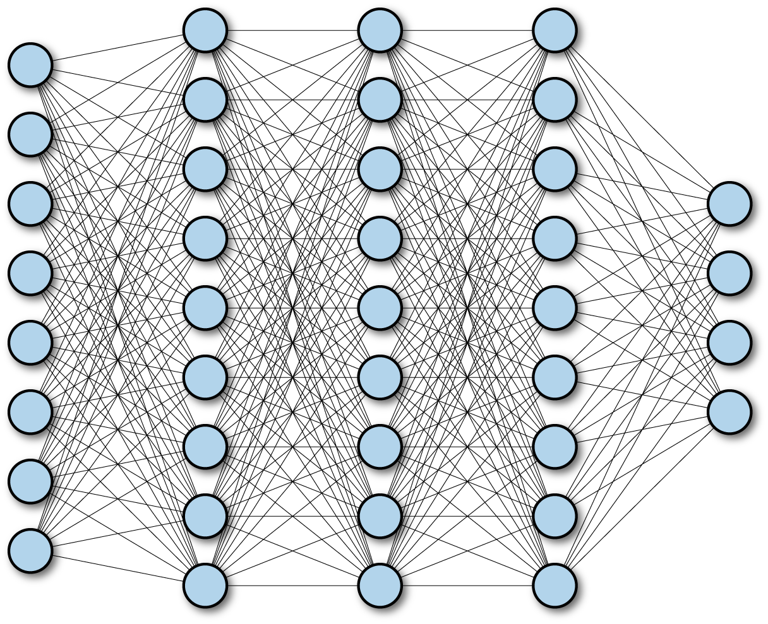
Neural Netowrk
FCNN (Fully Connected Neural Network)
Layer
Input
Output
ResNet (Residual Network)
Layer
1
Layer
2
Layer
3
Layer
4
Input
+
+
Output

Slide 9
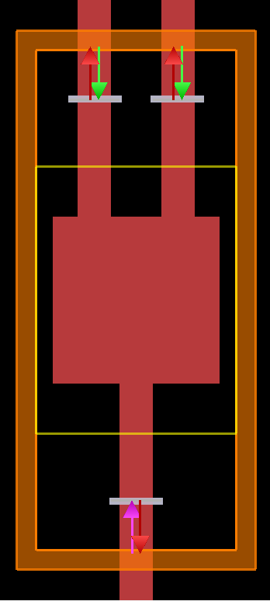
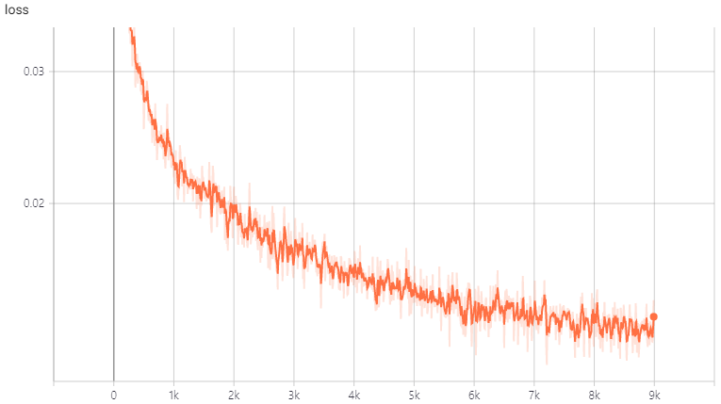
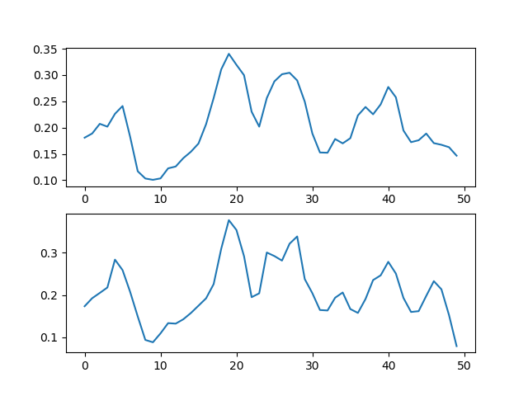
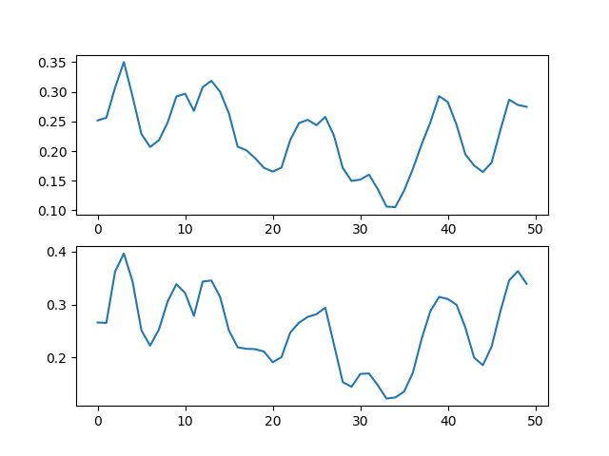
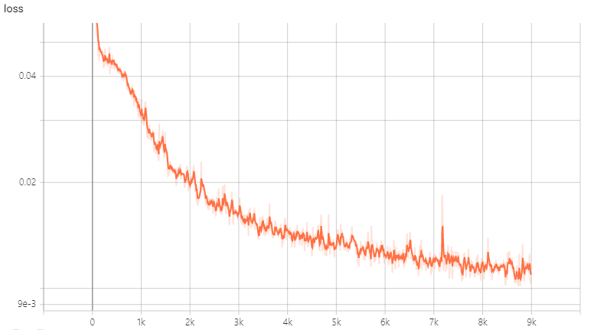


Training Result
$$f\left(x\right)=g\left(x\right)+l(x)$$
$$loss= \left|f\left(x\right)−g\left(x\right)\right|$$
FDTD
Neural
Network
loss
FCNN
Neural Network
Transmission
~ 0.015
FDTD
ResNet
Wavelength
Learning Step
Neural Network
Transmission
FDTD
~ 0.010
Wavelength
Learning Step
M. H. Tahersima, K. Kojima, T. Koike-Akino, D. Jha, B. Wang, C. Lin, and K. Parsons, “Nanostructured Photonic Power Splitter Design via Convolutional Neural Networks,” Conference on Lasers and Electro-Optics, 2019.

